Slide 1
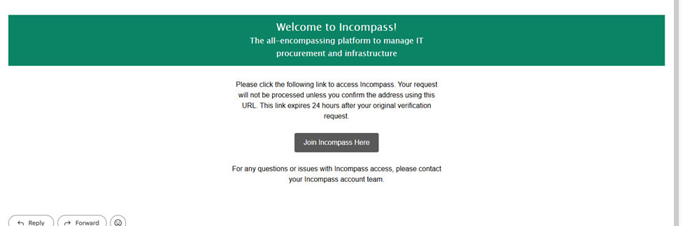
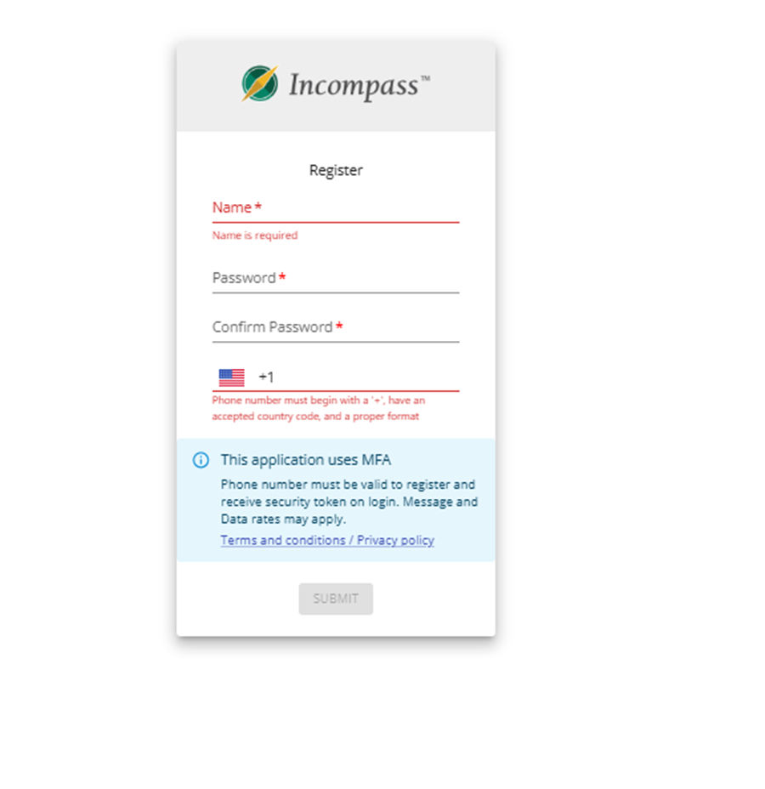
Click on “Join Incompass Here” inside the Welcome to Incompass email
**The link to sign up is valid for 36 hours. If you have not received the email, check your Spam/Junk Mail or email IncompassHelpEGI@ergogroup.com
**A phone number that receives SMS is required. If you do not have a phone or tablet that receives SMS text, please reach out to IncompassHelpEGI@ergogroup.com

Slide 2
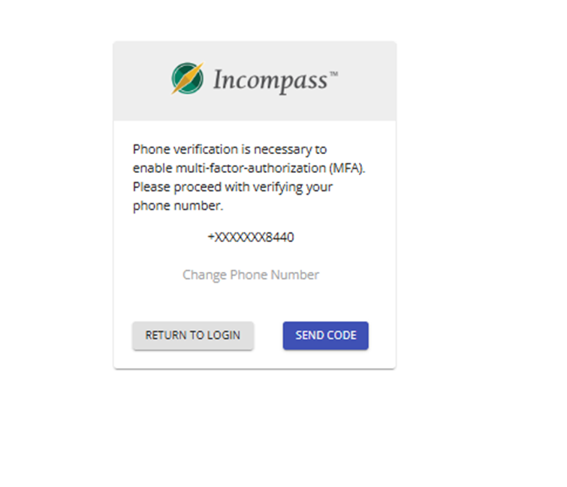
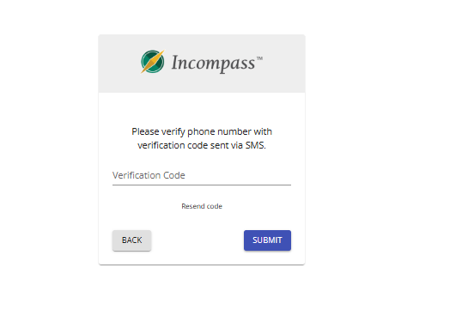
Click Send Code
**If you entered your phone number incorrectly click “Return to Login”
Enter verification code received via SMS and hit Submit. Once you hit Submit the page will re-direct to the Main Dashboard screen.

