Slide 1
IS Change Management Overview Training
ITSM Program
changemanagement@partners.org
<date>

Slide 2
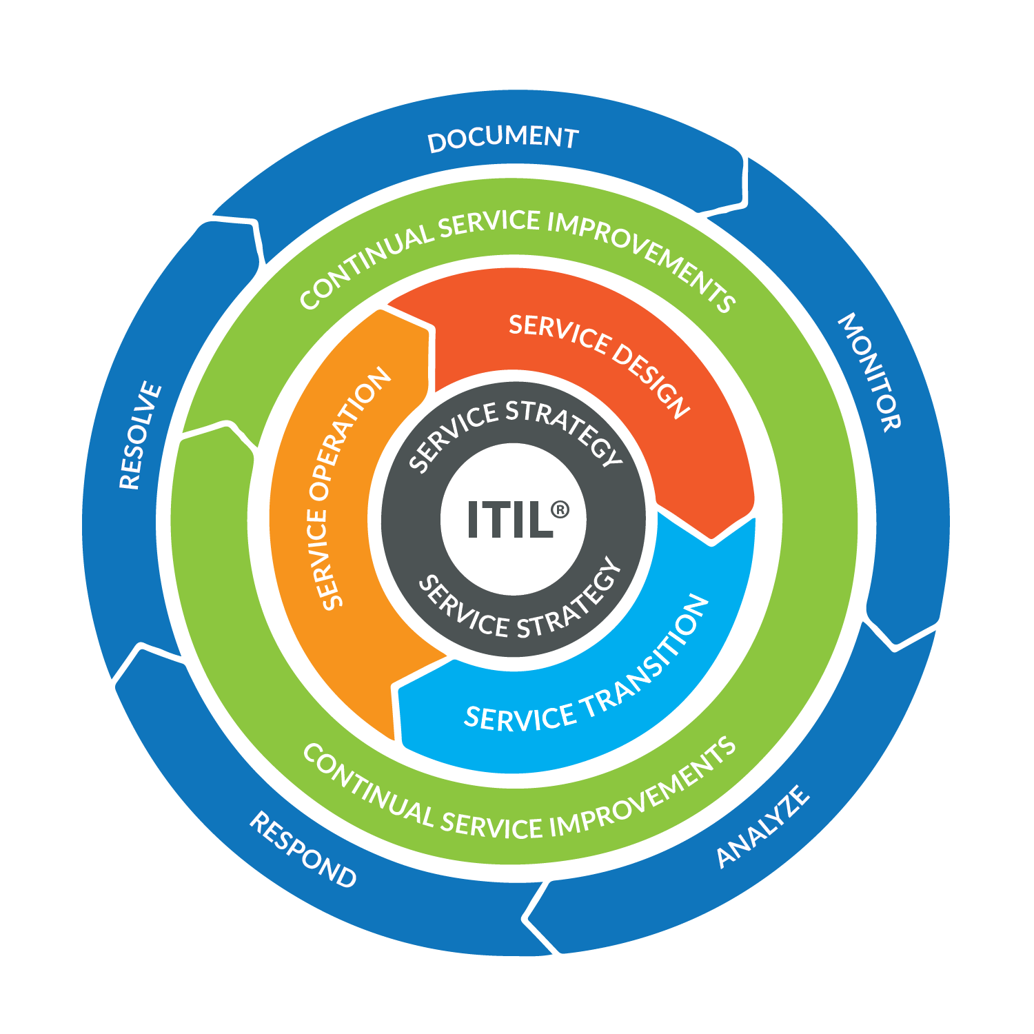
Agenda
What is a Change?
What is Change Management?
Process Overview
What is a Change Freeze?
Questions?
Benefits of Change Management

Slide 3
High Reliability Organization
A cultural shift to focus on:
Error prevention
Transparency
Situational Awareness
Five Principals
Preoccupation with Failure
Reluctance to Simplify Interpretations
Sensitivity to Operations
Commitment to Resiliency
Communication at All Levels
Goal: Zero serious events of preventable harm. An enterprise wide commitment to do things Right, the First time, Every time

Slide 4
Our Mission
Mission
Patient Care
Discovery
Community
Teaching
The Whole is Greater Than
The Sum of Its Parts.
Aristotle

Slide 5
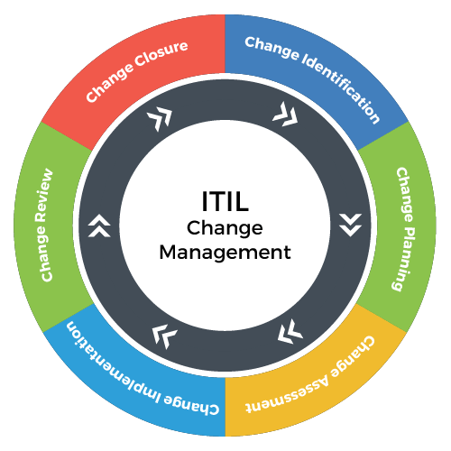
What is a Change?
ITIL – A detailed set of practices for IT Service Management that focuses on aligning IT services with the need of the business.
Change - The addition, modification or removal of anything that could have an effect on IT services.

Slide 6
What is Change Management?
Standardized methods and procedures
Used for efficient and prompt handling of all Changes to control IT infrastructure
To minimize the number and impact of any related incidents upon service
* 80% of unplanned outages are due to ill-planned changes made by operations staff or developers

Slide 7
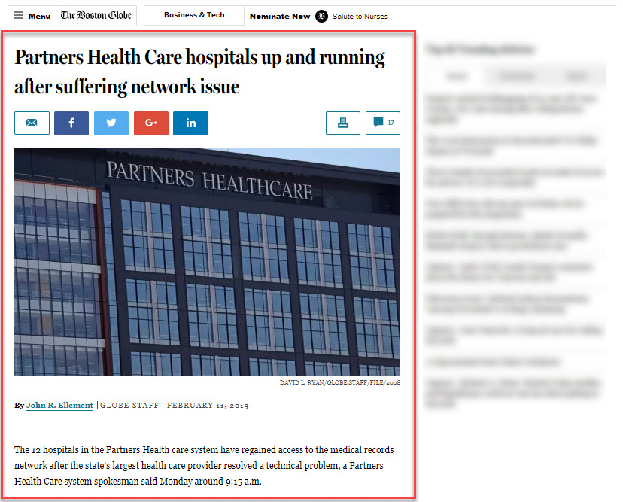
Impact of Changes
Undocumented change
Disrupted business for multiple hours
Reduced schedules and cancelled procedures

Slide 8
Process Overview

Slide 9
Change Management Roles
Roles include:
Change Requester
Change Approver
Change Implementor
Change Manager
Change Control Board (CCB)
Change Advisory Board (CAB)

Slide 10
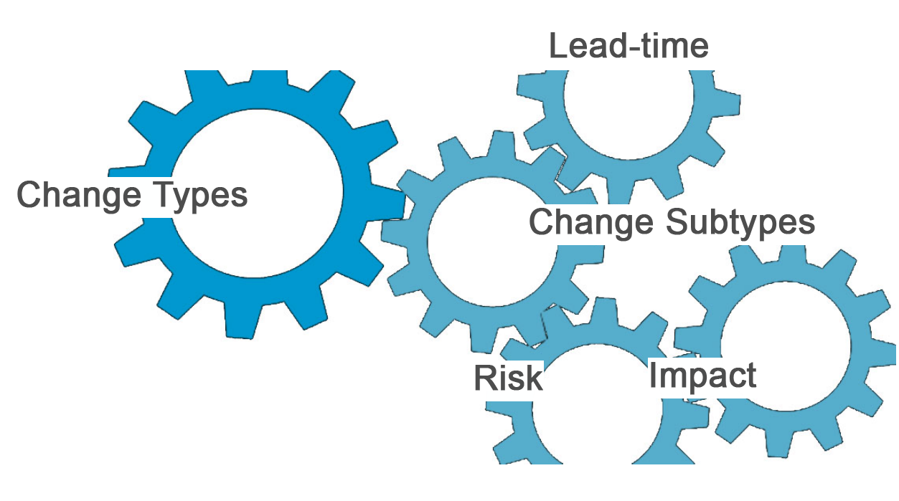
Change Types, Subtypes, Lead-Time, Risk, and Impact

Slide 11
Change Types
Normal
Changes that allow for adequate lead-time.
Expedited
Changes that do not allow adequate lead-time
Emergency
Changes with less than 30 minutes lead-time (or past)
Pre-Approved
The Pre-Approved change type provides a template for introducing low-risk, routine changes to the environment
Often poor planning, but can be to address service issue
These are typically used to resolve a service interruption
Pre-Defined
Reoccurring change with defined set of tasks, & may involve multiple groups

Slide 12
Risk
Low – Unexpected is not likely
Simple technology; few steps or records updated <10,000
Medium – Unexpected is likely
Technology is not routine, multiple steps, not a process redesign; or records updated <100,000
High - Unexpected is very likely
Standard type of procedure that is executed often
Quickly implemented & backed out by a single person
Nonstandard type of procedure and associated with level of difficulty
Implementing or backing out may be time consuming or more than one person
Technology is complex, involves a process redesign or records updated >100,000
Technology procedure requires high level of multidisciplinary skill sets
Knowledge of implementing or backing out is spread among disparate IS teams

Slide 13
Impact
Low – Few Users
Medium – Many Users
High - All or Majority of Users
Isolated significance only
Users can work
Communication is targeted to a few groups
Neither isolated nor Enterprise significance
Users can work intermittently or use workarounds
Communication is targeted to many groups but may not be across the Enterprise
Enterprise-wide significance
User can work intermittently, use workarounds, or cannot work
Communication is targeted across Enterprise via various channels

Slide 14
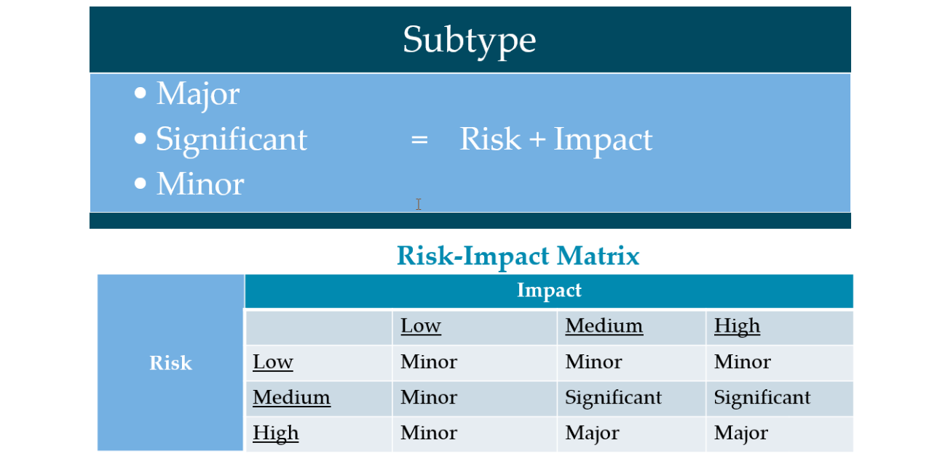
Determining the Change Subtype

Slide 15
Lead Time for a Normal Change
Minor
Minimum 2 days
Significant
Minimum 7 days
Major
Minimum 30 days
Lead-Time = Change Creation – Start Date of Change

Slide 16
Change Approval by Type and Subtype
Normal*
Minor
Significant
Expedited*
Minor
Significant
Emergency*
Significant
Minor
Major
Major
Major
CI Owner & Manager
CI Owner & Manager
CI Owner & Manager
CI Owner & Manager
CI Owner & Manager
CI Owner & Manager
CI Owner & Manager
CI Owner & Manager
CI Owner & Manager
IS VP
CCB
IS VP
CCB
IS VP
CCB
IS VP
CCB
Emergency CCB
Emergency CCB
Emergency CCB
*All Changes require an exception approval during a freeze.

Slide 17
Workflow for Normal, Expedited, & Emergency Changes
Draft
Awaiting Approval
Awaiting Implementation
Implement
Support
Close

Slide 18
Workflow for Pre-Approved Changes
Completed Minor Change
Request
Approval
Complete Template
Implement

Slide 19
Change Management Meetings
Changes of the Day
(COD)
Daily M-F
7:45 AM
Last 24 Hours (Major Incidents)
Change
Control Board
(CCB)
Weekly
Wed 3:00 PM
Next 7 Days Significant & Major Changes
Change
Advisory
Board
(CAB)
Monthly with CAB Members Only
Policy & Process Update Discussions
Next 24 Hours (Significant & Major Changes)

Slide 20
Subtypes, Lead times, and Meetings
Major
Significant
Minor
Pre-approved
SOP
Minimum lead time: 30+ days for normal change
Meetings: CCB
Risk is high & impact is all users
Meetings: CCB
Risk is medium & impact is many users
Meetings: None
Risk is low & impact is few users
Meetings: None
Risk very low & no impact
Minimum lead time: 7+ days for normal change
Minimum lead time: 2+ days for normal change
Minimum lead time: None
Document Repository
No recorded change
Meetings: None
* The change type is automatically calculated by change subtype & lead time.

Slide 21
Change Compliance

Slide 22
What is a Change Freeze?
A Change Freeze is a period of time when changes are restricted

Slide 23
Change Freeze Types
Enterprise
Site Specific
No Changes for the entire Enterprise
No Changes for that Site or any Enterprise Change that impacts that Site

Slide 24
Change Freeze Periods
Planned
Unplanned
Events with large crowds
Critical Application Upgrades
Local Emergency
Unannounced visits (e.g.: Joint Commission)

Slide 25
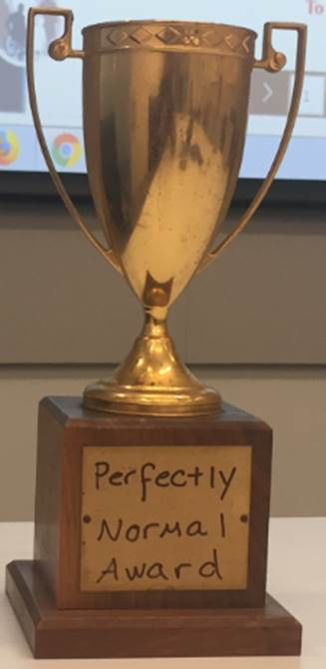
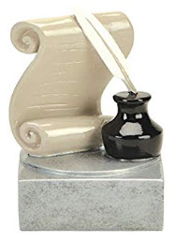
Change Awards
Perfectly Normal Award
Perfectly Written Award

Slide 26
Questions?
Thank you!
ITSM Program
changeManagement@partners.org

